Slide 1
Apache Web Server (httpd) and the AMP Stack

Slide 2
Technology Solution Stacks
Stack – Components designed to work together to provide support for a specific purpose.

Slide 3
Remember the Three-Tier model
Presentation Layer (User Interface)
Web Server
Application Layer (processing)
Application Server
Data Layer (database)
Database Server

Slide 4
AMP Stack
Apache (Web Server)
Presentation Layer
PHP (Server-side Language)
Application Layer
(Perl/Python sometimes included/substituted)
MySQL (Relational Database)
Database Layer

Slide 5
AMP Stack
Variations depending on OS
LAMP: Linux
MAMP: Mac
WAMP: Windows
XAMPP: Cross Platform
We’ll discuss MySQL and PHP in other lectures.
Today we’ll focus on Apache.
Notes:
Apache PHP and MySQL works in the every OS defined here.
Installation and configuration defers from OS to OS

Slide 6
About the Apache server
Often referred to as “httpd”
HTTP Daemon
Listens for and responds to requests over HTTP(S)
Documentation about Apache Web Server v2.4
http://httpd.apache.org/docs/2.4/
Notes:
You don’t have to memorize all the configuration modules that I am going to talk to you today,
You can find most of the information in the Documentation page and there are lots of online resources to look up.

Slide 7
Why we learn about Apache?
Source: https://news.netcraft.com/archives/2018/01/19/january-2018-web-server-survey.html

Slide 8
Apache HTTP Server Overview:
Free and Open Source Technology
Multiple Scripting Language Support (PHP, Python, Perl ...)
Runs all Operating Systems
Web Server with modular design (you can enable or disable existing modules or add brand new modules)
Simple, Powerful file-based configuration.

Slide 9
Anatomy of Apache Server
Httpd
Is the actual server executable/process
However it is not invoked directly by the user
It runs in the background
Apachectl
Is the front-end command to the httpd command
Apachectl command is used to start/stop/restart the server
In some AMP distributions there are GUIs with buttons to do the Apachectl start/stop/ restart

Slide 10
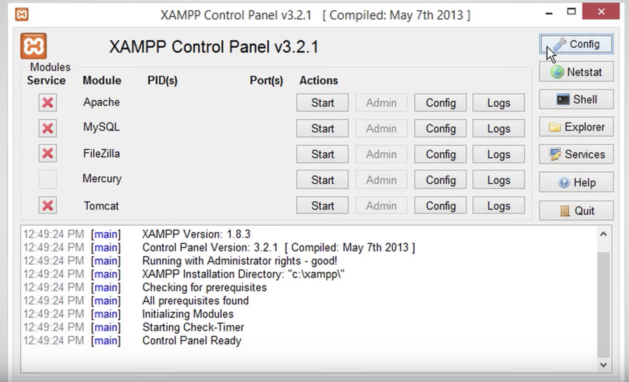
XAMPP – GUI
Graphical User Interface of the XAMPP

Slide 11
Anatomy of Apache Server
Web root
Root directory of files served from your website
Some examples of the web root folder in different OSes
htdocs
public_html
www
/var/www/html (or some variant)
Modules: Extend the functionality of server
Configuration files

Slide 12
Apache Server Configuration Files
Found in two places
httpd.conf
Main configuration
.htaccess
Directory-based overrides
Notes:
http://httpd.apache.org/docs/2.4/howto/htaccess.html

Slide 13
httpd.conf
Main Apache configuration
http://httpd.apache.org/docs/2.4/configuring.html
Exact location depends on OS
Usually somewhere in “etc” folder

Slide 14
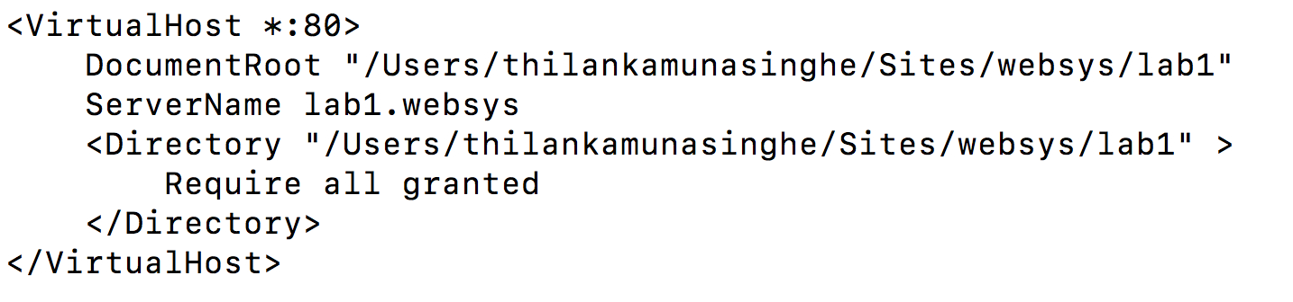
Anatomy of httpd.conf
# - Comment delimiter
Read the comments!
Configuration settings are called directives
Where those settings live in the file are called contexts
Blocks limiting directives to a location or resource are called containers
Notes:
This is an example of a container

Slide 15
httpd.conf Contexts
“server config” - Anywhere in httpd.conf or includes except:
<VirtualHost> containers
<Directory> containers
“virtual host” - is in <VirtualHost> containers
“directory” – in <Directory> (limits by filesystem), <Location> (by URL) and similar
You will see more on this later....
Notes:
Except for these two which are, (VirtualHost> container and <Directory> containers ) the rest of the things are the server configurations.
Directory container contains the information who can access the file system.

Slide 16
httpd.conf Contexts
Most common configuration errors are due to using a directive outside its context!
This often prevents the server from starting if it is misconfigured.
The server errors are logged in the error log file.
Notes:
If the “Contexts are misconfigured, and it will affect the server starting process

Slide 17
Httpd.conf example
#
# This is the main Apache HTTP server configuration file. It contains the
# configuration directives that give the server its instructions.
# See <URL:http://httpd.apache.org/docs/2.2> for detailed information.
# In particular, see
# <URL:http://httpd.apache.org/docs/2.2/mod/directives.html>
# for a discussion of each configuration directive.
#
# Do NOT simply read the instructions in here without understanding
# what they do. They're here only as hints or reminders. If you are unsure
# consult the online docs. You have been warned.
#
…
#
ServerRoot "/Applications/XAMPP/xamppfiles"
#
# Listen: Allows you to bind Apache to specific IP addresses and/or
# ports, instead of the default. See also the <VirtualHost>
# directive.
#
Listen 80
# 'Main' server configuration
#
# The directives in this section set up the values used by the 'main'
# server, which responds to any requests that aren't handled by a
# <VirtualHost> definition. These values also provide defaults for
# any <VirtualHost> containers you may define later in the file.
#
Directives

Slide 18
Httpd.conf example (cont)
#
# DocumentRoot: The directory out of which you will serve your
# documents. By default, all requests are taken from this directory, but
# symbolic links and aliases may be used to point to other locations.
#
DocumentRoot "/Applications/XAMPP/xamppfiles/htdocs"
#
# Each directory to which Apache has access can be configured with respect
# to which services and features are allowed and/or disabled in that
# directory (and its subdirectories).
#
# First, we configure the "default" to be a very restrictive set of
# features.
#
<Directory />
Options FollowSymLinks
AllowOverride None
Order deny,allow
Deny from all
</Directory>
Very important to know where your DocumentRoot is at
Sample Container

Slide 19
A note on paths
Relative paths
Are relative to the current directory, unless otherwise specified
Use “.” to specify the current directory
Use “..” to specify the parent
Absolute paths
Start with “/”

Slide 20
A note on paths
“/var/www/html” != “var/www/html”
First is from the root of your file system
The other is from where you currently are
(relative)

Slide 21
Anatomy of httpd.conf
Global Configuration
Main Server Configuration
Virtual Hosts Configuration

Slide 22
Global configuration
Defines how Apache will run
Generally we don't need to adjust much when we are just starting off...

Slide 23
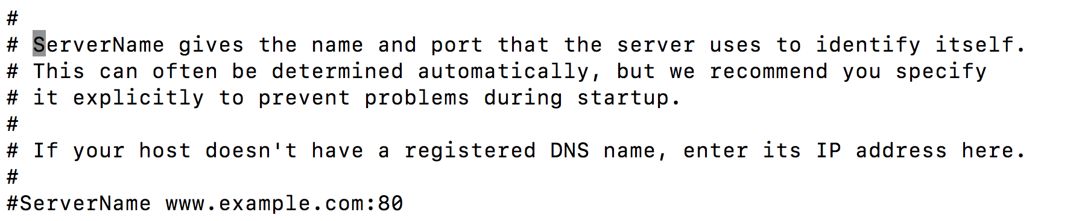
Global config directives
ServerRoot <path>
Root directory where the server lives. Any other relative paths relative to here
ServerName <fqdn>:<port>
Fully Qualified Domain Name (FQDN) and default port of main server
ServerAdmin <email>
Default contact email
Notes:
ServerRoot is the Root directory where the server lives. Any other relative paths relative to here
ServerRoot is the place where Apache installation code lives

Slide 24
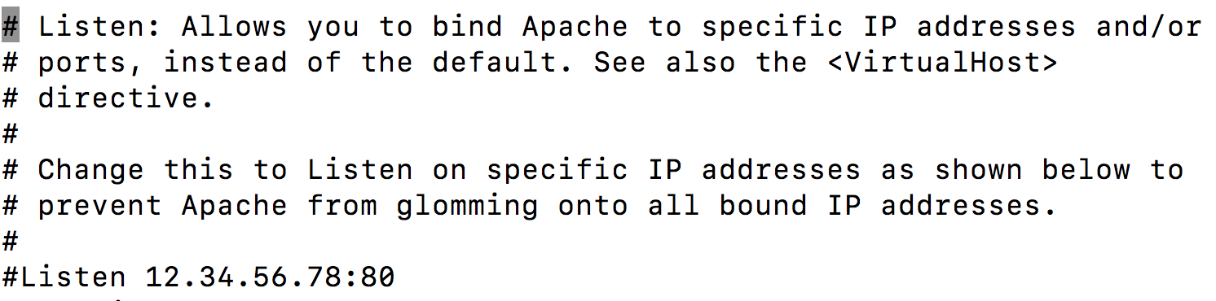
Global config directives
Listen [<IP>:]<port>
Defines IP/port to listen on
Multiple Listen directives = multiple ports
Timeout <seconds>
Seconds before requests timeout
You will see more on this later …

Slide 25
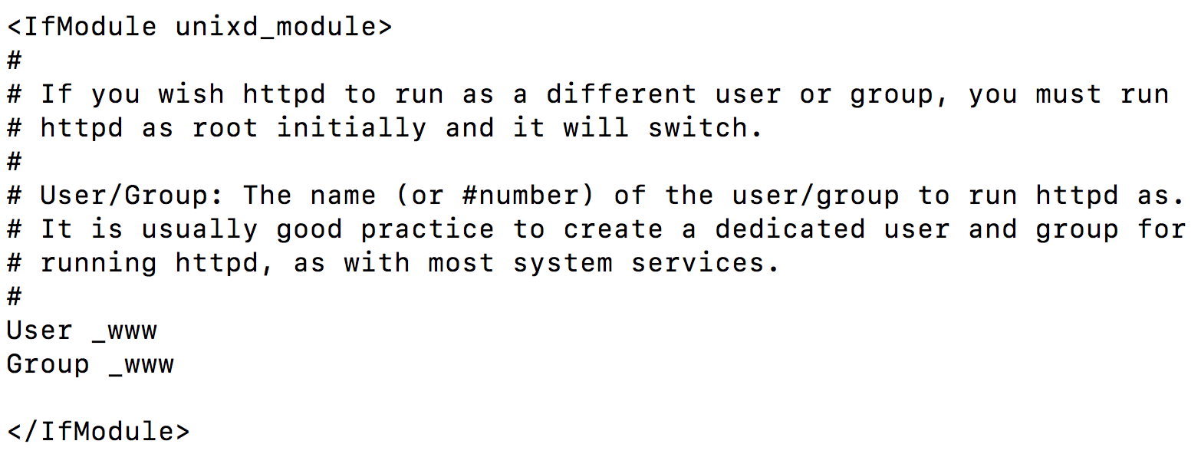
Global config directives
User <username> / Group <groupname>
User/Group httpd runs as
This is important when giving server permission to read/write/execute files, but not others

Slide 26
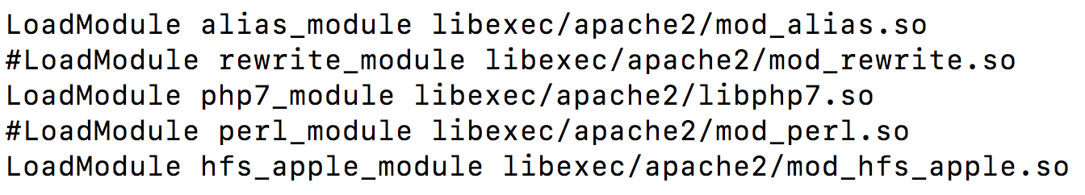
Modules
Extend functionality
Can provide their own directives to do so
Read the documentation!
Notes:
Modules are Extend functionality
Here are some examples of the modules.
When you want to activate a module, you have to uncomment it, which means removing the HashTab or the PoundSymbol in front of the module.

Slide 27
Modules
LoadModule <path/to/module>
Loads the specified module
<IfModule module_name>
directives…
</IfModule>
Conditionally process directives if a module has been enabled
This helps Prevent errors if a module has been removed
Notes:
LoadModule Loads the specified module

Slide 28
Module examples
php7_module (libphp7)
PHP 7 support
rewrite_module (mod_rewrite)
Allows for dynamic rewriting of URLs

Slide 29
Main Server configuration
This applies to the “main” default server
Answers all requests not received by a virtual host
<VirtualHost>
DocumentRoot “/web-dir/location1”
ServerName website1
</VirtualHost>
vhost config
1
<VirtualHost>
DocumentRoot “/web-dir/location2”
ServerName website2
</VirtualHost>
2
localhost
3
DocumentRoot “/web-dir/defaultlocation”
ServerName localhost
main server config
Notes:
Main Server Answers all requests not received by a virtual host
So this, means When you have defined a virtual servers, first the requests are matched to the virtual servers. If they can not match, then they will go to the main server config.

Slide 30
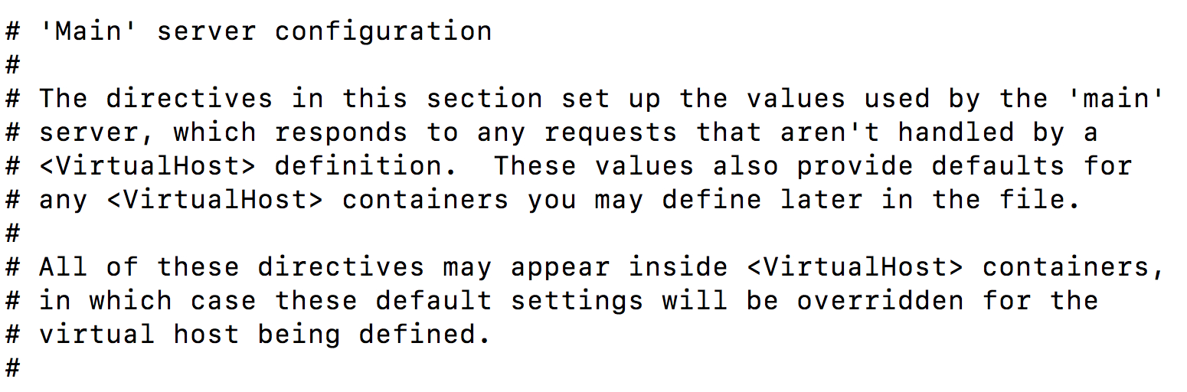
Main server configuration
DocumentRoot <path>
The Web root discussed earlier
Directory-based configuration...
Notes:
This is how the Main server configuration starts.

Slide 31
Directory based configuration
Apache can configure directories to behave differently
Many uses
Different applications need different settings
Access control
Notes:
You can do this by using the htaccess file.

Slide 32
Directory based configuration
<Directory path>
directives...
</Directory>
Apply configuration settings to the named directory
Also applies to all subdirectories!

Slide 33
Common directory-based directives
Options <options...>
Set flags for features available, “all” is default (check docs for list)
Most specific option set takes precedence
Options can be specifically enabled or disabled by prefixing all options in that directive with + or -

Slide 34
Directory-based access control – pre 2.4v
Order ordering
Ordering – “Allow,Deny” or “Deny,Allow”
Determine the order in which Allow and Deny directives are evaluated
Those that don't match any rules use the second
Ie
Order deny, allow
Deny from all
Allow from dev.example.com
Notes:
http://httpd.apache.org/docs/2.4/mod/mod_access_compat.html

Slide 35
Directory-based access control
Allow from rule
Rule: all, hostname, ip, env-variable
Declare which hosts can access the directory
Partial IPs and
Deny from rule
Same syntax, but denies access

Slide 36
Directory-based overriding
AllowOverride <setting>
Define when and whether to allow .htaccess files to override settings
Setting: All, None, Options, FileInfo, AuthConfig, Limit

Slide 37
Directory-based access control – 2.4+
Require
Old:
Order deny, allow
Deny from all
Allow from example.org
Is now
Require all denied
Require host example.org
https://httpd.apache.org/docs/2.4/upgrading.html
Notes:
http://httpd.apache.org/docs/2.4/mod/mod_access_compat.html

Slide 38
.htaccess
Not a typo: filename is preceded with a dot
Can be placed in any subdirectory of DocumentRoot
Overrides behavior in httpd.conf
Has its own context: “.htaccess”
Notes:
.htaccess file

Slide 39
Common uses of .htaccess
Directory-level access control (original usage)
URL rewriting/redirecting
Enabling/disabling features for certain sites or subdirectories
Packaging necessary/suggested server config changes with a Web app

Slide 40
Use .htaccess when ...
Setting configuration from an app to be deployed elsewhere
Need to control configuration at the directory level
You don't have access to httpd.conf (common on shared hosting)

Slide 41
Don’t use .htaccess
Whenever you have access to the httpd.conf file
From Apache documentation:
“You should avoid using .htaccess files completely if you have access to httpd main server config file. Using .htaccess files slows down your Apache http server.”

Slide 42
.htaccess concerns
Additional overhead
.htaccess is checked every request
httpd.conf changes updated on server restart
Parent directories also searched
Security concerns
Possible to override security settings
File permissions need to be set carefully

Slide 43
Virtual hosts
Inherits defaults from “main” server
Allow you to “fake” multiple Web servers from same Apache install
Separate Web roots, configs...
Very handy when developing!
Two major forms
Name based virtual hosts
IP/port based virtual hosts
You will see more on this later ….
Notes:
Main detault one
http://localhost/
Two other virtual hosts are
http://thilanka.info/
http://lab1.websys/

Slide 44
IP-based virtual hosts
Use the IP address of the connection to determine the correct virtual host to use
Needs separate IPs for each virtual host
Not everyone has access to multiple IPs!

Slide 45
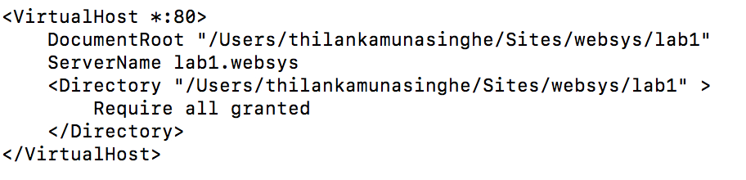
Name-based virtual hosts
Use the HTTP “Host” header to determine which virtual host to use
This is Safe, since it's required by HTTP/1.1+
Commonly used for...
Subdomains
Local dev environments
* Refers to any IP
The Host header in the HTTP 1.1 request is mapped to the ServerName
Notes:
IP-based virtual hosts use the IP address of the connection to determine the correct virtual host to serve. Therefore you need to have a separate IP address for each host. With name-based virtual hosting, the server relies on the client to report the hostname as part of the HTTP headers. Using this technique, many different hosts can share the same IP address.
Name-based virtual hosting is usually simpler, since you need only configure your DNS server to map each hostname to the correct IP address and then configure the Apache HTTP Server to recognize the different hostnames. Name-based virtual hosting also eases the demand for scarce IP addresses.

Slide 46
Recall from the previous lecture…
HTTP Request Header
Host: <domain name>
“This is the domain name I'm referring to.” Required in HTTP/1.1.
E.g: Host: lab1.websys

Slide 47
Name-based virtual hosts
NameVirtualHost ip:port
Listen for name-based virtual host requests on this IP and port
<VirtualHost ip:port>
directives…
<VirtualHost>
This is a container for virtual host configuration for a given IP and port
IP wildcards (“*”) are legal

Slide 48
Name-based virtual host example
#
<VirtualHost *:80>
ServerName example.com
DocumentRoot /var/www/example.com
# More config happens
</VirtualHost>

Slide 49
Wait a minute...
How do we find the IP address for our domain name?

Slide 50
Wait a minute...
How do we find the IP address for our domain name?
DNS Server!
We need a DNS entry
But since we're developing in our own little world, we'll cheat...
Notes:
DNS = Domain Name System

Slide 51
No DNS record? No Problem
Remember, you can tell DNS requests to resolve a specific way in your hosts file!
Give it any name you want
Common convention: “mysitename.local”
Assign it to resolve to localhost
Can be used to set up multiple virtual hosts locally

Slide 52
The rest of the stack...
MySQL [or MariaDB] (Relational Database)
Database Layer
PHP (Server-side Language)
Application Layer
Module
(Perl/Python sometimes included/substituted)
We will talk more on them later …

Slide 53
Your OS
Obvious, but worth mentioning!
Different tools, different file locations
Even depending on distributions
For this course, use what you're comfortable with based on your OS.
Notes:
Distro =

Slide 54
About MySQL
SQL – Structured Query Language
Relational Database
Novice-friendly
Robust enough for professional use on small- to mid-sized sites

Slide 55
PHP
PHP Hypertext Preprocessor
This is a Server-side language
It is Interpreted, not compiled
We'll talk about this more later during the course!
Notes:
Read and translated to intermediate “opcode” before processing every page request

Slide 56
Recommended Software
VirtualBox, VM Ware, etc...
XAMPP
http://www.apachefriends.org/en/xampp-macosx.html
intelliJ IDE, Eclipse, etc...
(use what you are most comfortable with including Notepad or Bbedit, etc if you like)
Sublime text editor (PC/Mac/Linux), Atom, notepad++, Bbedit (Mac), Textmate (Mac), etc…

Slide 57
</class>
Next class is Lab 1: Apache Server
Installation
Configuration
Virtual Hosts for multiple projects
Feel free to install the stack ahead of time
All labs require a working laptop
Future labs will build off of this one

